Slide 1
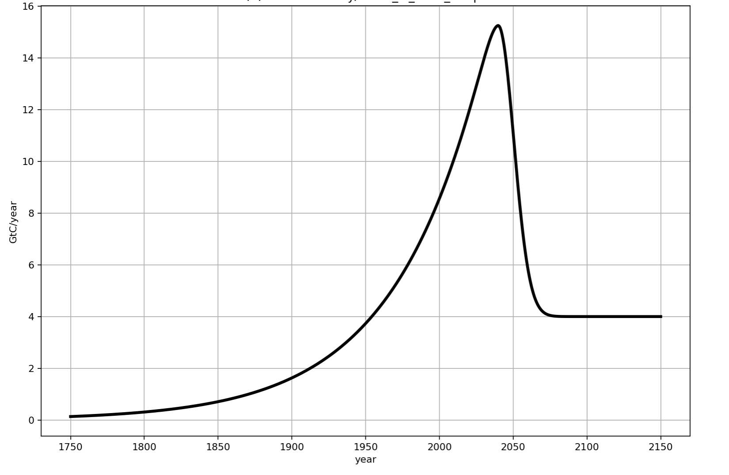
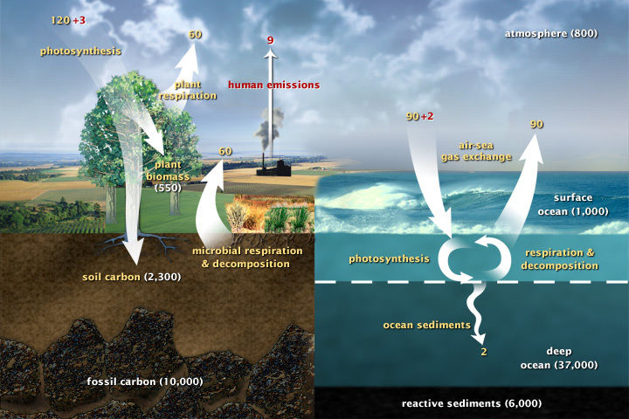
About Cambio 1.0: you’ll need an emissions scenario
In this scenario, anthropogenic missions peak in the year 2040

Slide 2
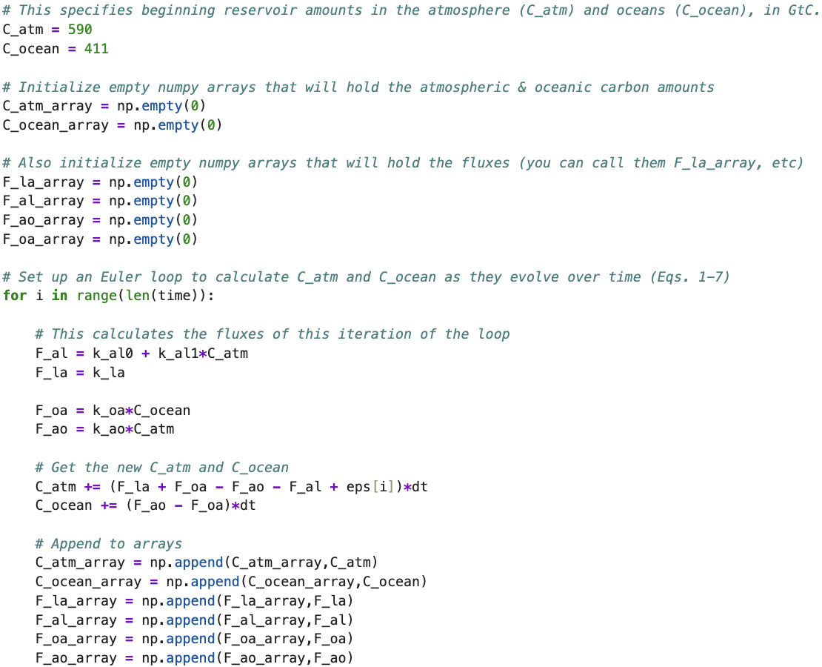
You’ll also need to set up an Euler loop that calculates changes to carbon in the atmosphere & ocean at each time step

Slide 3
You’ll also need to set up an Euler loop that calculates changes to carbon in the atmosphere & ocean at each time step
This keeps track of the changes so you can graph them (Graph #1 and #2)

Slide 4
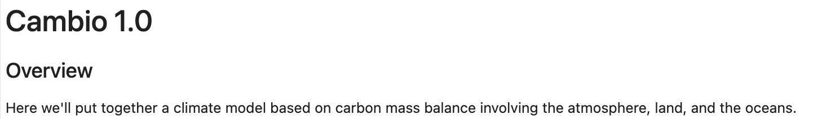
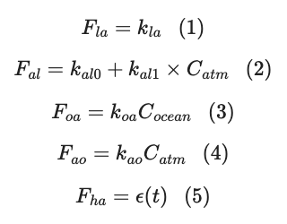
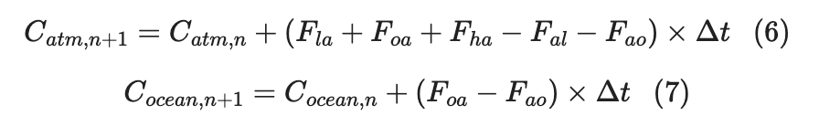
OK, let’s make some progress on this!

Slide 5
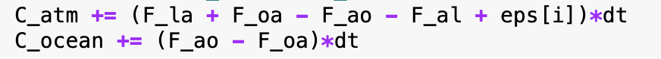
OK, let’s make some progress on this!

Slide 6
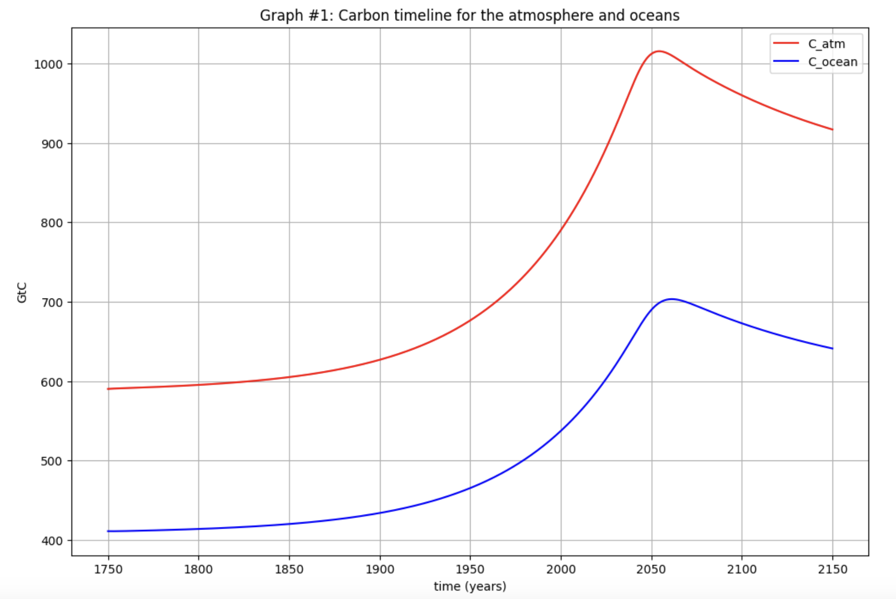
A preview of Cambio 1.0 results: Graph #1 (Carbon timelines)
Atmosphere: 590 GtC
Oceans: 411 GtC
Pre-industrial times

Slide 7
A preview of Cambio 1.0 results: Graph #1 (Carbon timelines)
Atmosphere: 800 GtC
Oceans: 544 GtC
2003

Slide 8
A preview of Cambio 1.0 results: Graph #1 (Carbon timelines)
Atmosphere: 922 GtC
Oceans: 621 GtC
2040 was the year emissions peaked in this scenario

Slide 9
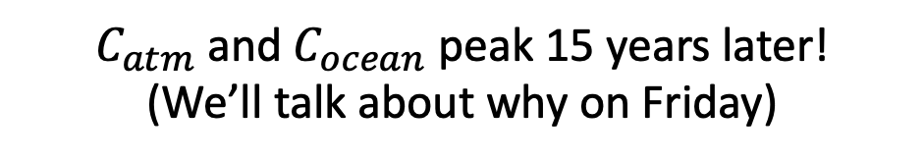
A preview of Cambio 1.0 results: Graph #1 (Carbon timelines)
Atmosphere: 1020 GtC
Oceans: 700 GtC
$C_{atm}$ and $C_{ocean}$ peak 15 years later!
(We’ll talk about why on Friday)

